Slide 1
Watson Analytics

Slide 2


Important disclaimer
IBM’s statements regarding its plans, directions and intent are subject to change or withdrawal without notice at IBM’s sole discretion.
Information regarding potential future products is intended to outline our general product direction and it should not be relied on in making a purchasing decision.
The information mentioned regarding potential future products is not a commitment, promise or legal obligation to deliver any material, code or functionality. Information about potential future products may not be incorporated into any contract. The development, release and timing of any future features or functionality described for our products remains at our sole discretion.
Performance is based on measurements and projections using standard IBM benchmarks in a controlled environment. The actual throughput or performance that any user will experience will vary depending upon many factors, including considerations such as the amount of multiprogramming in the user's job stream, I/O configuration, storage configuration and workload processed. Therefore, no assurance can be given that an individual user will achieve results similar to those stated here.

Slide 3
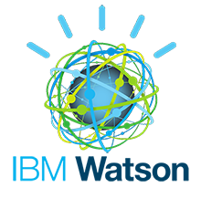
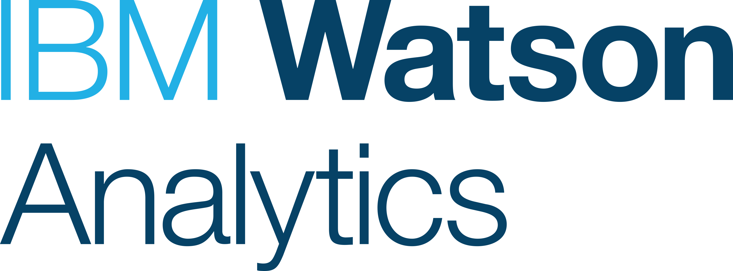
Powered by the Cognitive Capabilities of Watson
A technology platform of cognitive services, designed to assist, with solutions such as:
Watson for Oncology – Evidence-based treatment options
Chef Watson – a prime candidate for Food Network’s “Chopped”
And many other….
An offering based on the Watson platform - powerful yet easy to use analytics
Combines the cognitive capabilities of Watson with traditional analytics
Solving the traditional challenges of structured data
Assists a variety of users across an organization
Notes:
Slide summary
Talk about how the Watson aspect is delivering the ease of use in Watson Analytics
Define “cognitive”
Clarify the relationship between Watson/Watson Analytics
Example full script: You may have heard of the IBM Watson brand before, potentially from Jeopardy, or just from the fact that there are a number of different Watson offerings in market. The simplest way to think about the IBM Watson brand is that it is a platform of cognitive services, and there a number of differing offerings in market leveraging various pieces of that platform, to address specific opportunities. For example, there are the “Expert” type systems like Watson for Oncology – systems that take all types of data, structured, unstructured, that are being trained on a continuous basis by subject matter experts. On the other end of the Watson spectrum, you’ve got something like Watson Analytics, leveraging some of the cognitive concepts from Watson, focused on structured data, and slanted towards the traditional analytics space, instantly delivered via cloud, at a very attractive price.
What’s similar across all Watson offerings is the Cognitive theme, and at a high level, the concept of cognitive is about being “of assistance” to the user –Watson for Oncology is assisting doctors, chef Watson is assisting Chefs, Watson Analytics is assisting decision makers with a natural language dialogue, guidance, and suggestions throughout their experience.
So that’s the “easy” part – there’s a lot of innovation behind Watson Analytics, which is how we’ve delivered an offering with unprecedented ease of use. But let’s talk about the smarts, an equally important aspect as we’ve discussed.

Slide 4
Powered by the Cognitive Capabilities of Watson
Cognitive Solutions leverage a combination of cognitive system reasoning strategies and other analytic and classical computing techniques to solve for a problem. Cognitive solutions listed have at least (2) of the (4) characteristics below:
(1) The ability to Understand a request in the context of the domain it is being used in,
(2) The ability to Respond to the request with a level of reasoning, i.e. not a programmed response,
(3) The ability to Learn and through supervised machine learning, and
(4) The ability to Interact with the requestor, typically a human.
Notes:
Slide summary
Talk about how the Watson aspect is delivering the ease of use in Watson Analytics
Define “cognitive”
Clarify the relationship between Watson/Watson Analytics
Example full script: You may have heard of the IBM Watson brand before, potentially from Jeopardy, or just from the fact that there are a number of different Watson offerings in market. The simplest way to think about the IBM Watson brand is that it is a platform of cognitive services, and there a number of differing offerings in market leveraging various pieces of that platform, to address specific opportunities. For example, there are the “Expert” type systems like Watson for Oncology – systems that take all types of data, structured, unstructured, that are being trained on a continuous basis by subject matter experts. On the other end of the Watson spectrum, you’ve got something like Watson Analytics, leveraging some of the cognitive concepts from Watson, focused on structured data, and slanted towards the traditional analytics space, instantly delivered via cloud, at a very attractive price.
What’s similar across all Watson offerings is the Cognitive theme, and at a high level, the concept of cognitive is about being “of assistance” to the user –Watson for Oncology is assisting doctors, chef Watson is assisting Chefs, Watson Analytics is assisting decision makers with a natural language dialogue, guidance, and suggestions throughout their experience.
So that’s the “easy” part – there’s a lot of innovation behind Watson Analytics, which is how we’ve delivered an offering with unprecedented ease of use. But let’s talk about the smarts, an equally important aspect as we’ve discussed.

Slide 5
Powered by the Cognitive Capabilities of Watson
Watson Analytics does this by :
Understand –
it automatically understands your data,
it understands your NLP question,
it understands the context of the social media data,
it understands the quality of your data and tells you where their may be issues that can be corrected.
Reason –
it makes proactive suggestions or Starting Points from just uploading your data,
it knows the best visualization for the question or how to display the insights,
it uses analytics to "reason" or tell you what factors are influencing your targeted outcome
Learn –
it learns new insights or patterns within the data each time a user appends, slices, etc, and
overtime WA will be able to make suggestions on other data sources relevant to your use case
Interact –
it allows you to ask questions of your data using NLP,
it provides the ability to communicate your findings/insights via dashboards, collaboration/sharing and exporting
Notes:
Slide summary
Talk about how the Watson aspect is delivering the ease of use in Watson Analytics
Define “cognitive”
Clarify the relationship between Watson/Watson Analytics
Example full script: You may have heard of the IBM Watson brand before, potentially from Jeopardy, or just from the fact that there are a number of different Watson offerings in market. The simplest way to think about the IBM Watson brand is that it is a platform of cognitive services, and there a number of differing offerings in market leveraging various pieces of that platform, to address specific opportunities. For example, there are the “Expert” type systems like Watson for Oncology – systems that take all types of data, structured, unstructured, that are being trained on a continuous basis by subject matter experts. On the other end of the Watson spectrum, you’ve got something like Watson Analytics, leveraging some of the cognitive concepts from Watson, focused on structured data, and slanted towards the traditional analytics space, instantly delivered via cloud, at a very attractive price.
What’s similar across all Watson offerings is the Cognitive theme, and at a high level, the concept of cognitive is about being “of assistance” to the user –Watson for Oncology is assisting doctors, chef Watson is assisting Chefs, Watson Analytics is assisting decision makers with a natural language dialogue, guidance, and suggestions throughout their experience.
So that’s the “easy” part – there’s a lot of innovation behind Watson Analytics, which is how we’ve delivered an offering with unprecedented ease of use. But let’s talk about the smarts, an equally important aspect as we’ve discussed.

Slide 6
The evolution of Business Analytics tools
Generation One
Generation Two
Generation Now
Descriptive
Biased
Unbiased
Query, reporting & analysis
OLAP
Enterprise BI
Data Discovery
Self Service
Visualization
Smart data discovery
Cognitive technology
Storytelling / Collaboration
Modernized skill sets for enterprise BI
Governed data
+
+
IBM Watson Analytics
+
IBM Cognos Analytics
© 2016 IBM Corporation

Slide 7
IBM’s Analytic Tools Portfolio
What happened?
IBM Cognos Analytics
Descriptive
Get in touch with reality, a
Single source of the truth, visibility
What is our plan?
Why did it happen?
IBM Planning Analytics
IBM Watson Analytics
Planning
Diagnostic
Planning, budgeting, and
forecasting
Understanding why something
happened is a critical step
What should we do?
What will happen next?
IBM ILOG CPLEX
IBM SPSS
Prescriptive
SPSS
Predictive
Manage resource efficiency, utilization,
and allocation
Understand the most likely future
scenario and its business implications
Notes:
Leveraging data and driving better decision and outcomes should be the goal of your analytics strategy. Choosing how and where to start, and the right tools for the job, are often a difficult decision. While you could really start anywhere, we believe that gradually moving up this kind of maturity curve and layering on analytic capabilities that build upon one another is a sound approach. Starting with descriptive analytics, through the use of enterprise analytics capabilities, to disseminate trusted and key information across the organization (the “what”). Moving on to diagnostic analytics, which help you understand the “why”. Building upon that, with predictive analytics, to help make the “why” more actionable, and deployable. Followed by prescriptive analytics, which leverages the layers below to provide optimization, and efficient and effective actions.
IBM’s analytics portfolio has been designed strategically to support this progression, providing tools that are integrated, which complement one another, with the reuse of technology throughout. This started back in 2008 with the significant acquisitions of Cognos and SPSS. This is not a new strategy – we’ve worked through the challenges of integrating different cultures and software as a result of acquisitions, and have arrived at this complete set of tools that can truly help organizations progress along this analytics maturity curve.

Slide 8
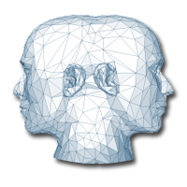
Smart Data Discovery: Going Beyond What You Know
Blending cognitive and advanced analytic capabilities to enable users to:
Challenge the status quo
Explore the unknown
Get a deeper understanding of outcomes
Identify patterns and relationships in the data
Notes:
Purpose: Describe smart data discovery, and position it as revolutionary (i.e, there are no offerings that compete)
Transition to next slide: Introducing Watson Analytics, offering smarter discovery…
…and that opportunity is to go beyond what it is that you know - to question the way things have always been done, to get a deeper understanding of outcomes.
Analytics traditionally have been geared toward what it is that you know, based on your experience and your knowledge. The report and dashboard that you build is only as good as your understanding of your subject. And as the old saying goes, you don’t know what you don’t know. The idea of smart data discovery is to unleash the untapped potential that is realized by combining the inquisitive nature of people with the data that they have at their disposal. Given the increasingly competitive landscape that organizations face, and the pressure to outperform, this is something that organizations need to embrace.
And while there are many offerings in market that offer their version of “data discovery”, the idea of smart data discovery is still foreign to most. The desktop vendors (the tableaus and Qliks of the world) simply give you another mechanism to create content based on what you know, and focused on flashy visualizations and pretty pictures, with much of their value marginalized with the redesigned experience in Cognos Analytics.
With Watson Analytics, we deliver on the true smart data discovery…

Slide 9
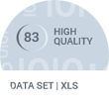
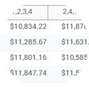
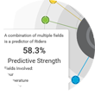
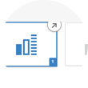
IBM Watson Analytics: Smarter Data Discovery
Watson Analytics strikes a balance between ease of use and powerful capabilities to deliver where others cannot
Smart metadata to automate working with your
data sources
Cognitive guidance in the form of starting points
and suggestions
Advanced analytics in the form of pattern and relationship detection, without requiring specialized skills
Access to social media sources to get an external perspective
Notes:
Purpose: Introduce Watson Analytics as the solution that enables smarter data discovery
Transition to next slide:
Watson Analytics is ideally positioned for this situation - it allows the business user with no real analytical knowledge to perform advanced analytics of data without any requirement of deeper knowledge. I.e. Watson Analytics takes the role of an IT person and or a data scientist on behalf of the user. Have in mind that many people define the difference between standard and cognitive systems, that the cognitive system actually give assistance, it does work for you like a partner in crime. Also note that the genesis for these analysis could in fact be driven from observations made in the enterprise system, like something going extremely well or poorly. Integration is critical here. The other dimension is where business users have deeper questions that require them today to bring in data scientists or at least people with advance analytics skills. This is when you would ask questions such as “why is something” rather than “what is it”. So this is about which kind of analytics people do. It just isn’t good enough anymore to simply show a great picture but you can answer what drove the business to it. People want to understand why thing are as they are.

Slide 10
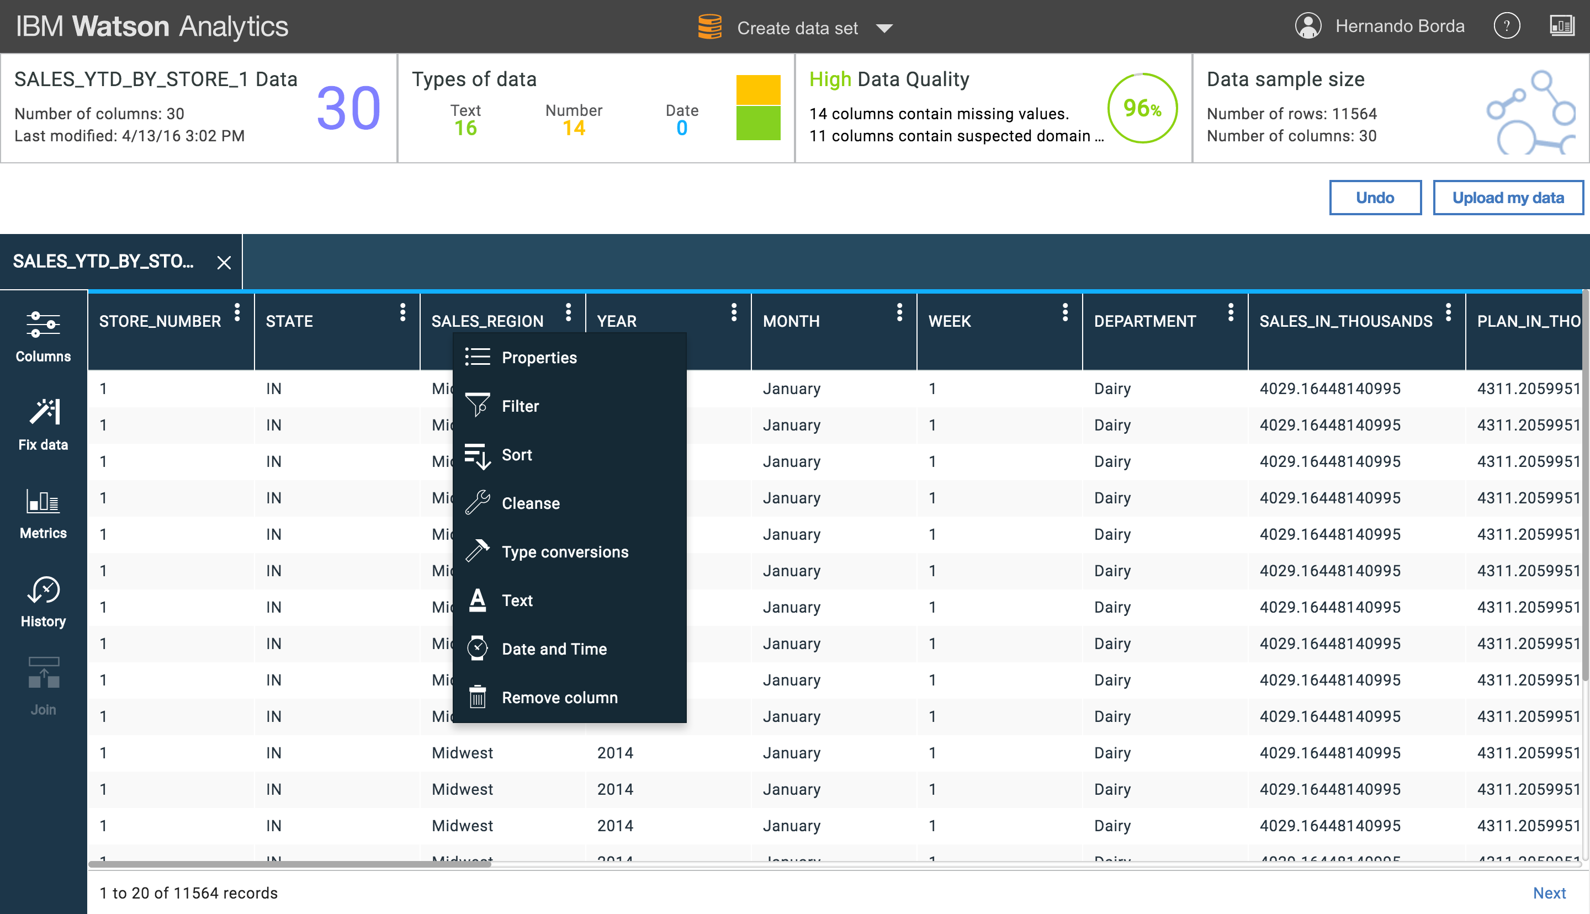
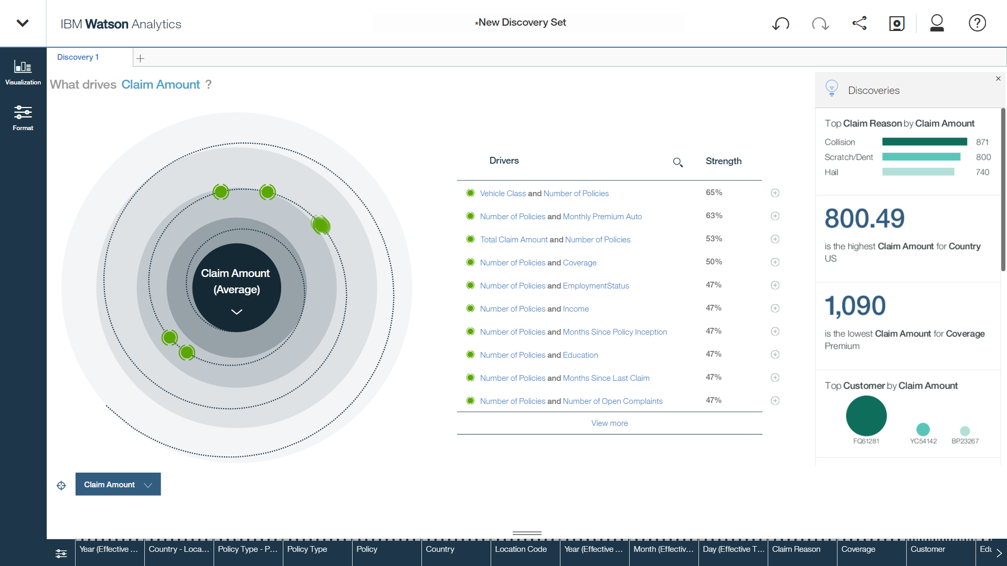
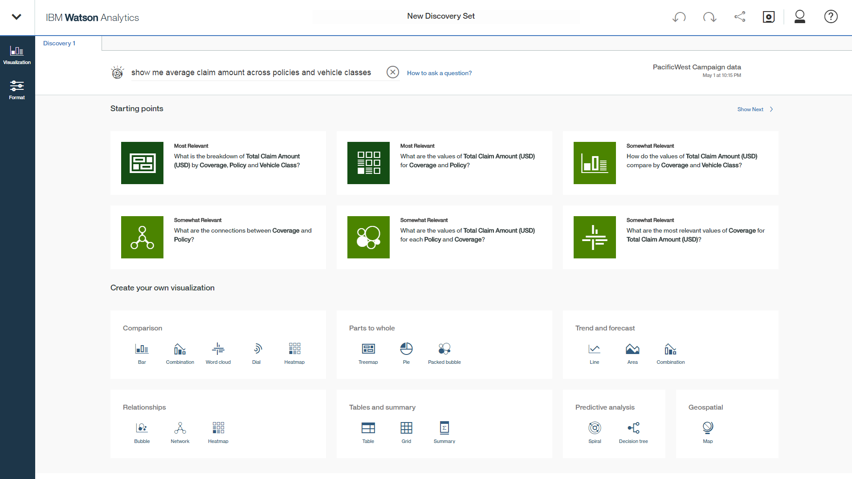
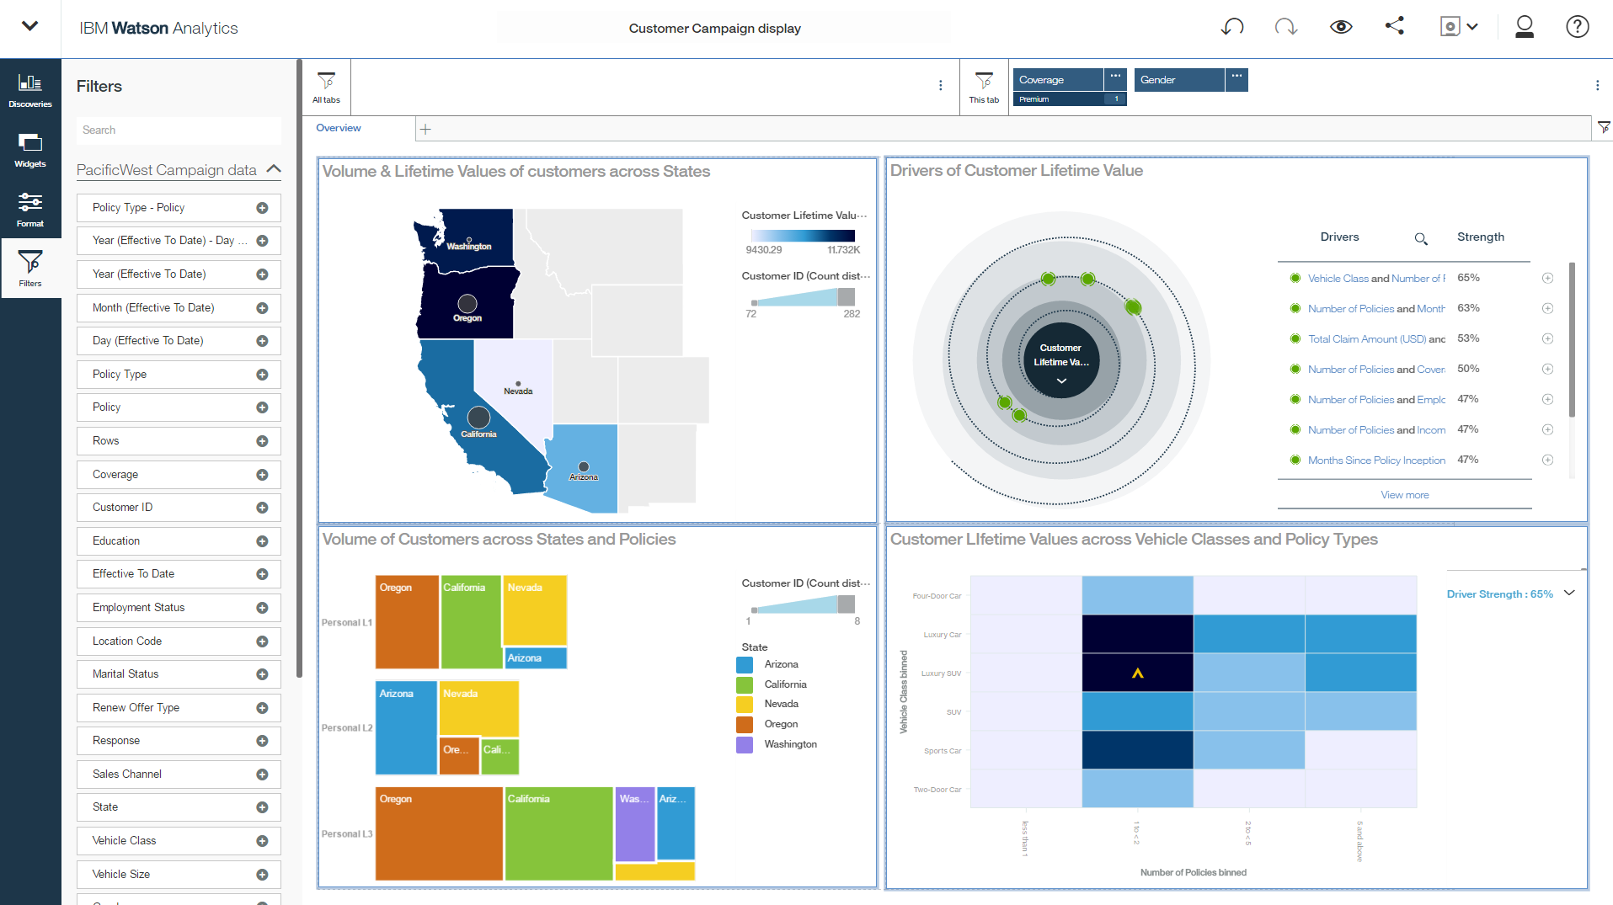
Unique capabilities
All the benefits of advanced analytics without the complexity
_{Data prep made easy}
_{Understand outcomes}
_{Guided exploration}
_{Share insights}
Notes:
Differentiators:
Self-service analytics in the cloud. Upload and cleanse your data, then discover insights, predict outcomes, visualize results, create reports or dashboards, and collaborate with others.
Automated data access and refinement, predictive analytics, and visual storytelling. Accelerate time to value and interface with a visualized data that helps users focus on understanding and communicating results to stakeholders.
Natural language processing. Using natural language queries, search within Watson Analytics and find comprehensive results, clear explanations and confident outlooks in terms familiar to your business.
Predictive analytics. Reveal unforeseen patterns and relationships based on relevant facts, inspiring the right questions to ask that direct users to the answers that matter most.
Further talking points:
Watson Analytics helps you make more informed decisions to move your business forward in some very important ways, which we’ll explore more in-depth throughout the next few slides:
Business users want a consumer-like experience to use analytics and data to pursue ideas, get answers to all types of questions, make predictions, and communicate compelling recommendations without needing help from anyone.
However, they are hampered by the usability of analytics tools, access to data and dependency on others – both IT to provide the infrastructure and data scientists to provide the analytical expertise.
With Watson Analytics, data-driven decisions can now be an essential, daily and interesting activity for business people.
Watson Analytics jumpstarts your analysis. It automates intelligence to accelerate your ability to get to the answers you’re seeking. It immediately starts you off with a visual story that illustrates what you need to know.
Instead of fumbling over data or searching for answers, you can focus on understanding your business and effectively communicating results to others.
And, if you aren’t sure what you need to do, Watson Analytics automatically starts you off with ideas and guides you through analysis so you can find meaning in your information and make better decisions.
It even introduces additional capabilities you might find useful as you become bolder and want to dig deeper.

Slide 11
Watson Analytics Demo

Slide 12
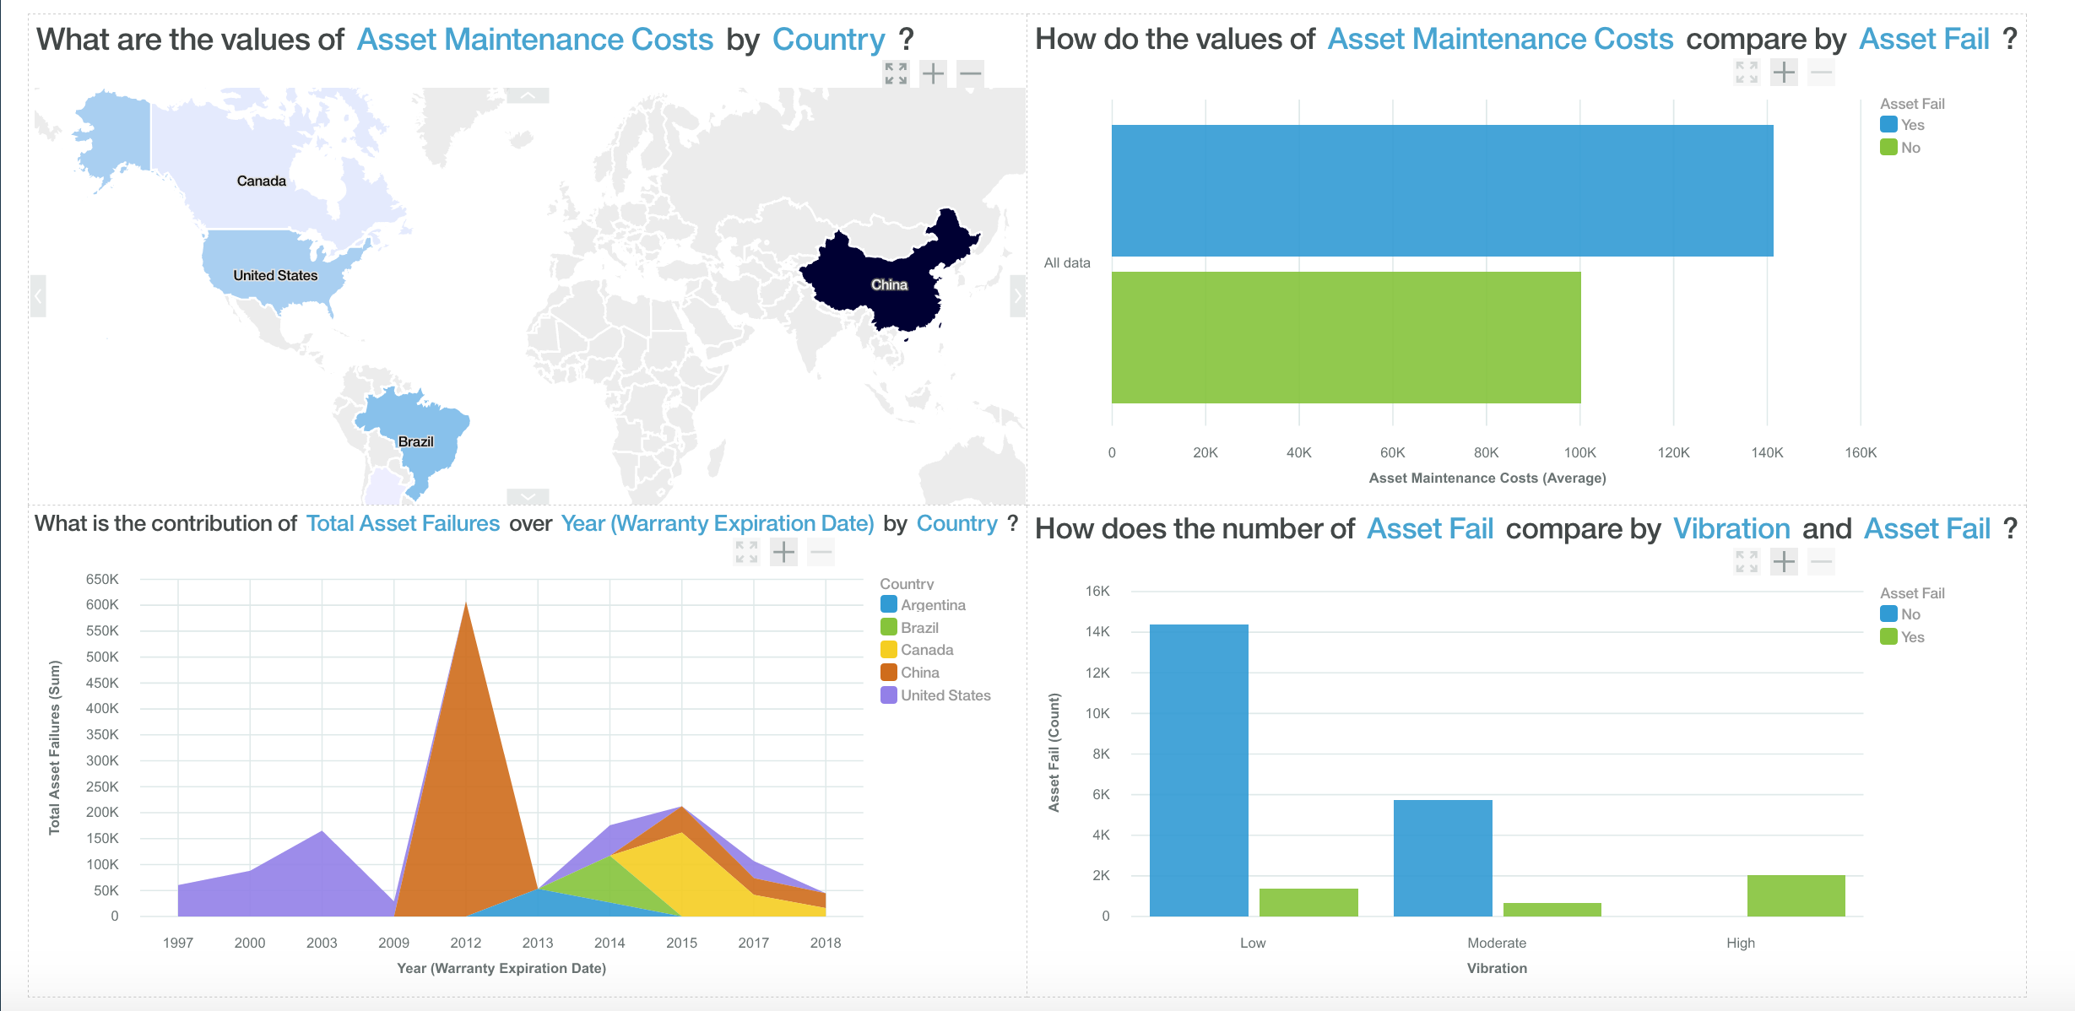

Slide 13
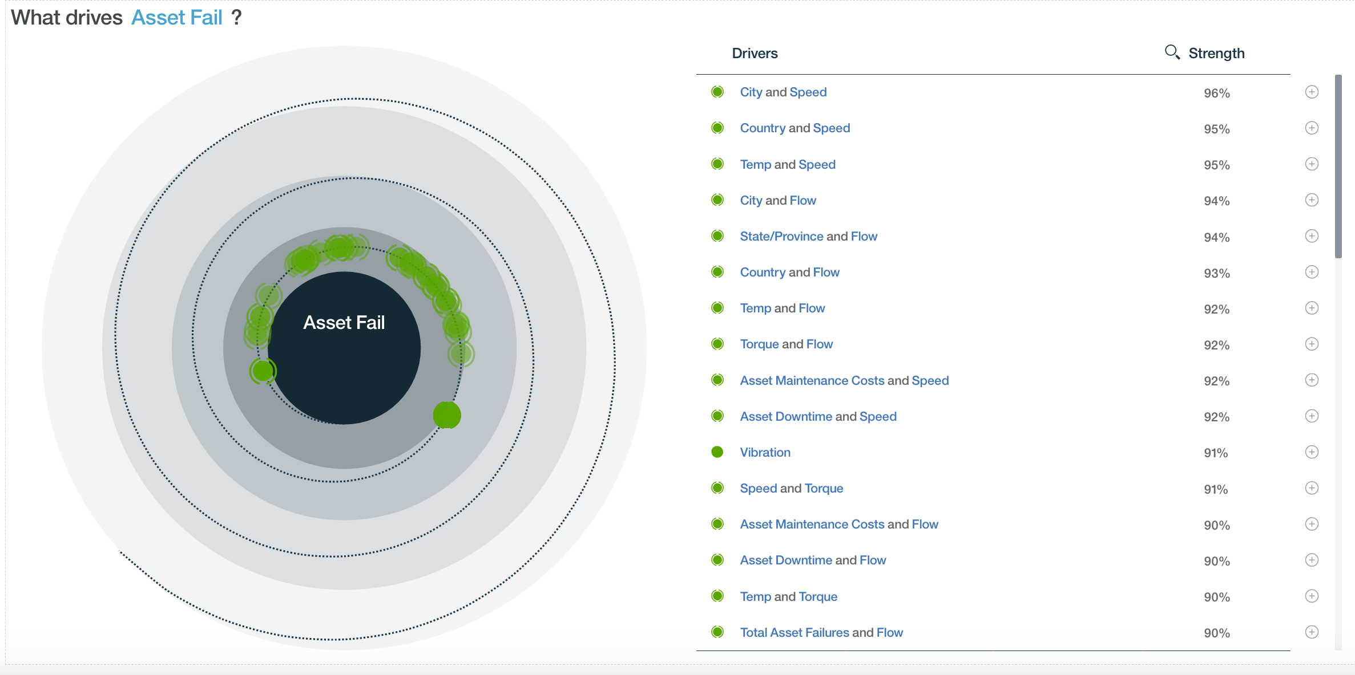

Slide 14
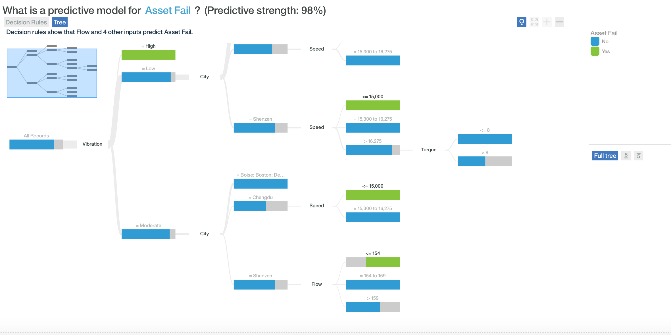

Slide 15
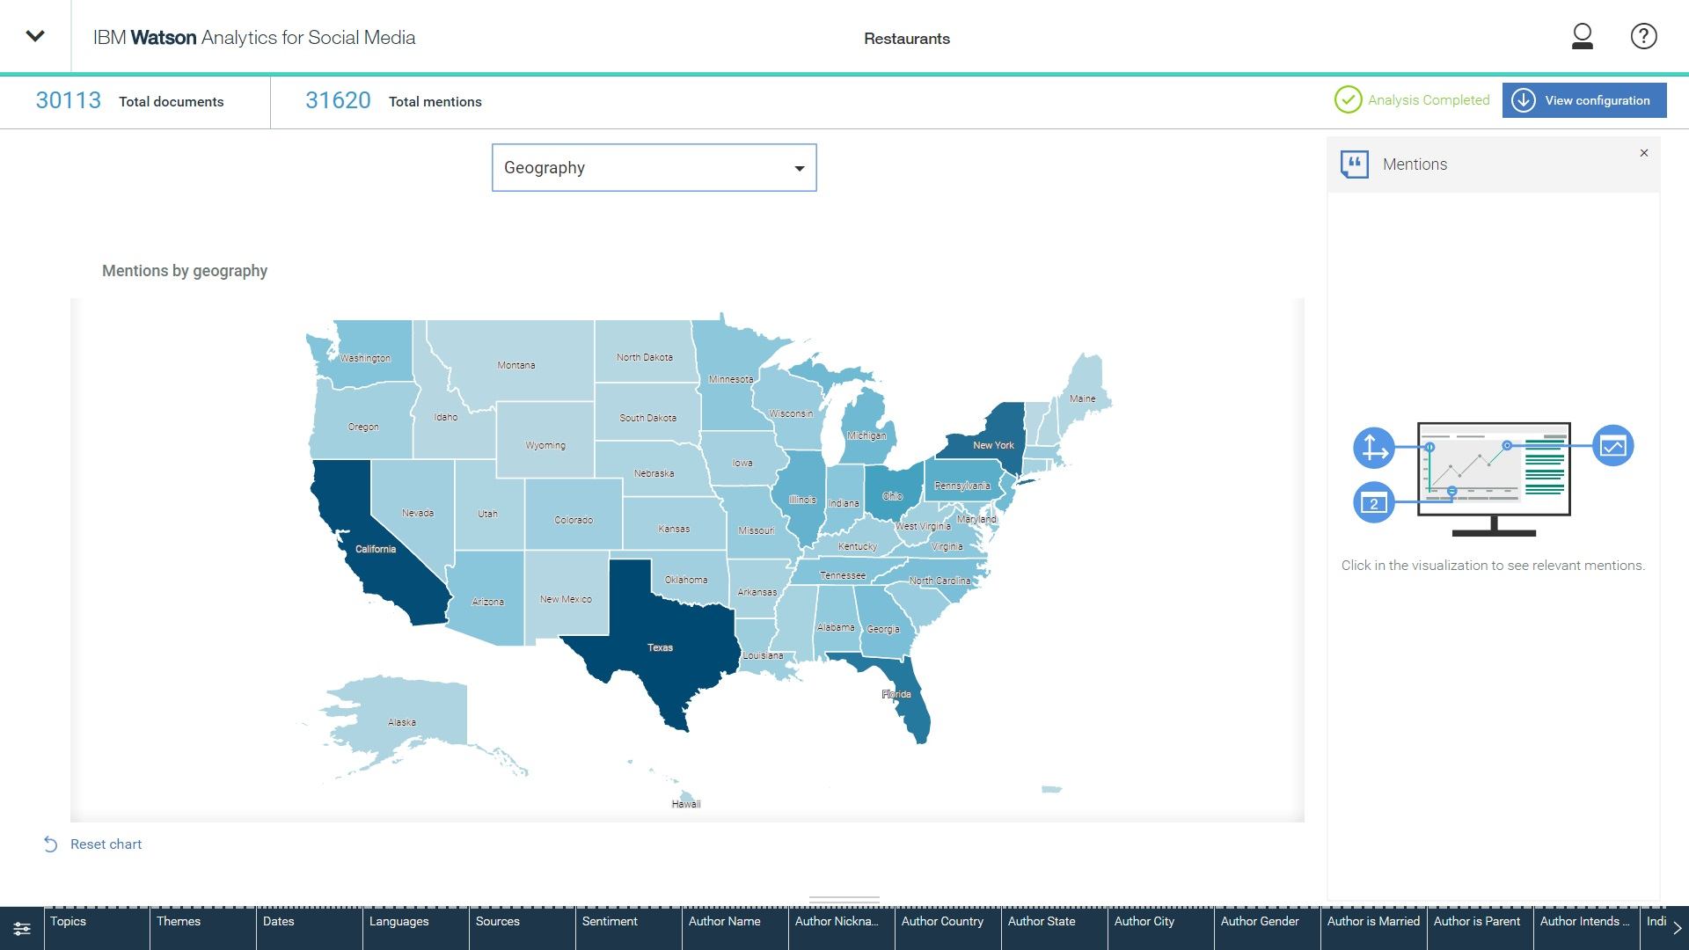
Watson Analytics for Social Media:
Watson Analytics for Social Media extends the cognitive platform of Watson Analytics to the social web
Access, understand, reason and learn from the highly valuable, unstructured information streaming across social channels.

Slide 16
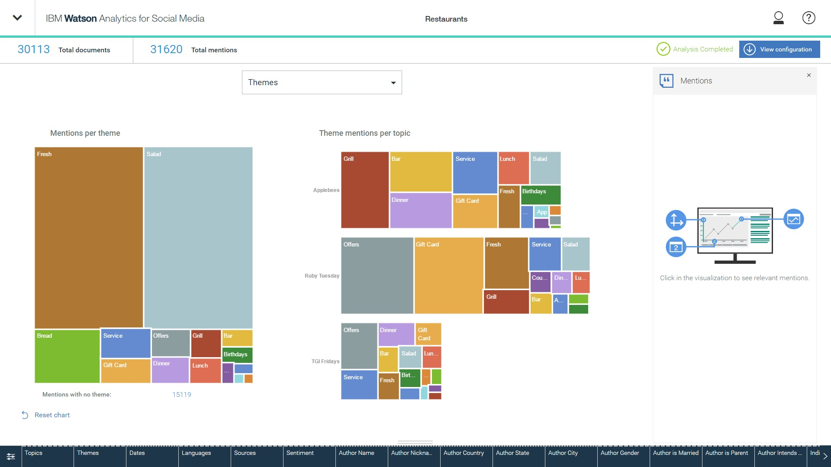
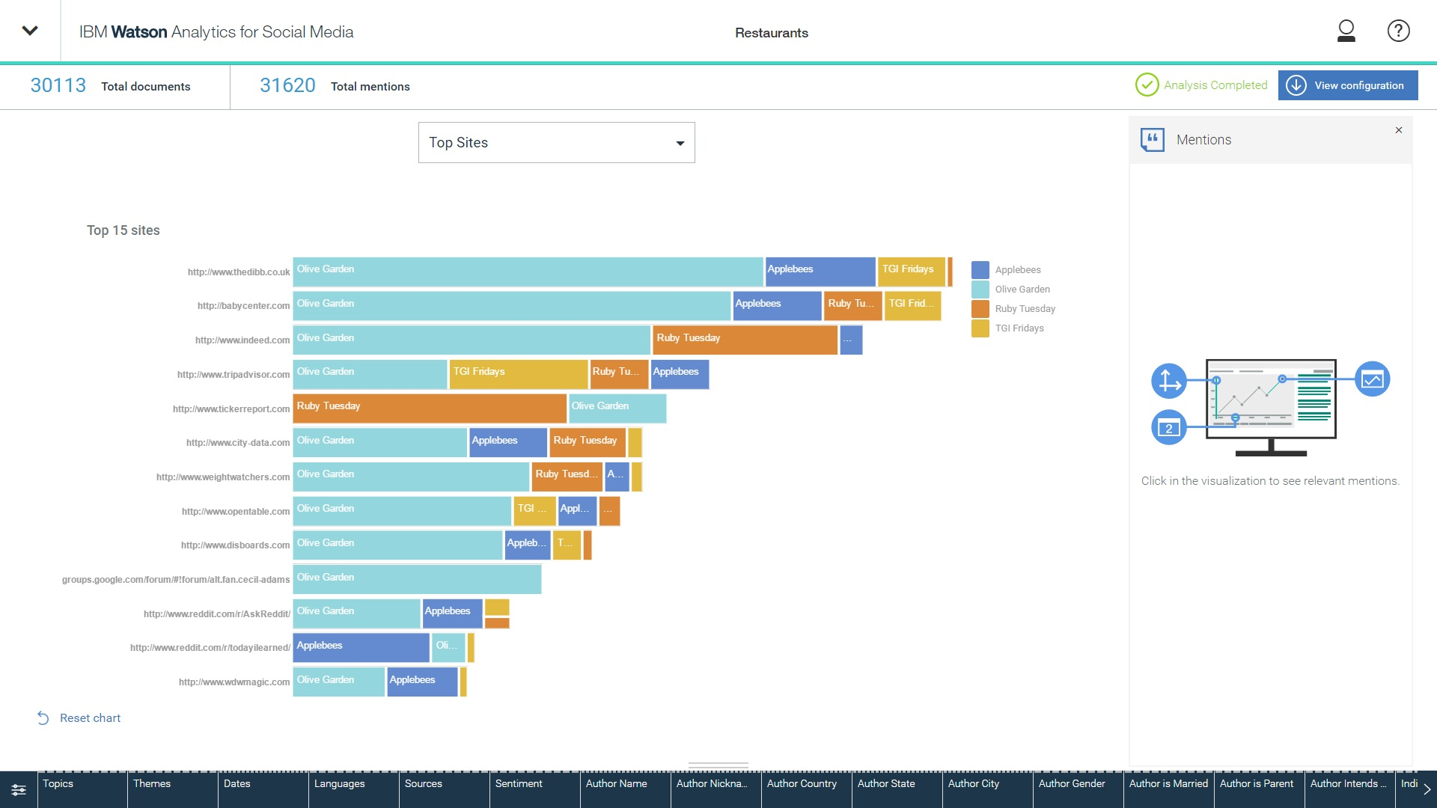
Identify the pulse of your audience:
Reveal insights in conversations across all social channels
Providing pre-built visualizations to highlight the most important insights

Slide 17







Watson Analytics Customer Use Cases
Where are we making a difference and how
Description
Sales
Marketing
Operations
Finance
Customer Support
Human Resources
IT
USE CASE CATEGORY
Interactive Data Visualization
Quickly find new insights in data with interactive visualizations, natural language, smart starting points and templates.
Pipeline Quality
Rep Compensation
Rep : Territory Fit
Sales Strategy
Sales Profitability
Sales Effectiveness
Campaign ROI
Customer Trends
Customer Profitability
Acquisition Cost
Customer Lifetime Value (CLTV)
Loyalty Program Management
Supply Chain Analysis
Asset Allocation
Utilization
Material Sourcing
Compliance
Injury Reports
Competitive Benchmarking
ROI Analysis
Risk
Program Analysis
Pricing Strategy
Plan : Actual Analysis
Profitability Analysis
Agent Performance
Case Complexity
Case Escalation
Repeat Calls
Customer Satisfaction
Salary Planning
Incentive Plan Effectiveness
Training Effectiveness
Employee Benefit Analysis
Labor Management Effectiveness
System Health
Ticket Analysis
SLA Analysis & Compliance
Defeat Cyber Attacks
Automatically Find Drivers of Behavior
Automatically build statistical models of your data. Confidently act on the findings thanks to visualizations and descriptive text which make results easy to understand.
Rep Retention
Opportunity Ranking
Deal Win/Loss Drivers
Cross-sell/Up-sell
Improve Response Rates
Customer Churn
Web Traffic Optimization
Inventory & Assortment Planning
Production Optimization
Distribution Route Prioritization
Outage Prediction
Collections
Missing Revenue
Fraud
Revenue Forecasting
Successful Resolution
Call Duration
Customer Churn
Recruitment
Attrition
Drivers of Successful Employees
Outage Prediction
Capacity Planning
Demand Forecasting
Analyze Social Media
Gain insight into the brands, organizations or topics of your choice on social media.
Competitive Awareness
Intent to Purchase
Brand Health, Attributes and Monitoring
Campaign Effectiveness
Supplier Awareness
Vendor Awareness
Investor Sentiment
Customer Sentiment
Proactive Customer Service
Loyalty Programs
Recruiting
Employee Activity Monitoring
Threat Assessment

Slide 18


